Slide 1
PROBLEM STATMENT
LEAF DISEASE DETECTION SYSTEM

Slide 2
TEAM- matrix
MEMBERS-
Prem Maity(7240)
​Karan Singh(7225)(leader)
Nithul k. Numbair(7232)
​Sri Sai Kosana Maheedhar (7227)

Slide 3
Introduction
India stands in the 2nd position in the fabrication of agricultural production. In vegetation, different forms of diseases come with the quality of the farm production. So, to detect the disease we used a DL based approach.

Slide 4
DOMAIN
Agriculture
Agriculture has been one of the foremost predominant fields of the Indian Economy. In the agricultural field, a serious role is being played by the disease detection in plants. The growth of the plants is affected because of the presence of the diseases in plants. As the majority of our population is based on agriculture sector and the food quality is a great concern to humanity hence we dedicated our project to agriculture.

Slide 5
objective
Make a system which can determine the status of a leaf as defected or good by image processing.

Slide 6
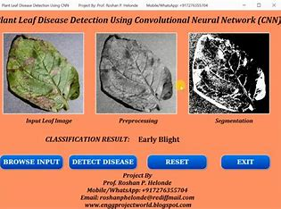
Explaination
In this Image processing project a deep learning-based model is proposed ,Deep neural network is trained using public dataset containing images of healthy and diseased crop leaves. The model serves its objective by classifying images of leaves into diseased category based on the pattern of defect.

Slide 7
Resources
Tensorflow
Tensorflow is a deep learning framework. It is an end to end open source platform used to train ML models. It mainly focuses on the related version that is suitable for running the program. It is used in large scale for ML, DL projects in our day to day life.
DeepLearning
Deep learning is used convert the human brain into process the information and creating different design in artificial intelligence (AI) that is used for making conclusion. It is a type of machine learning footing artificial neural networks during which multiple layers of transform are won't to extract more and more high-level features from data.
FCN
Full convolution neural network (FCN) is the basis of image semantics segmentation. At present, almost all semantics segmentation models are based on FCN. FCN first extracts and codes the features of the input image using convolution, then gradually restores the feature image to the size of the input image by deconvolution or up sampling.
Mask R-CNN
Mask R-CNN is one of the most commonly used image instance segmentation methods at present. It can be considered as a multitask learning method based on detection and segmentation network. When multiple lesions of the same type have adhesion or overlap, instance segmentation can separate individual lesions and further count the number of lesions.
YOLO
YOLO considers the detection task as a regression problem, and uses global information to directly predict the bounding box and category of the object to achieve end-to-end detection of a single CNN network. YOLO can achieve global optimization and greatly improve the detection speed while satisfying higher accuracy.

Slide 8
Future scope
Our future scope is to create a mobile app which will be useful for the farmers as a proper guide to do agriculture. In future, we can do the disease detection techniques using various parts of the crops or plants like stem, flower, and root.

Slide 9
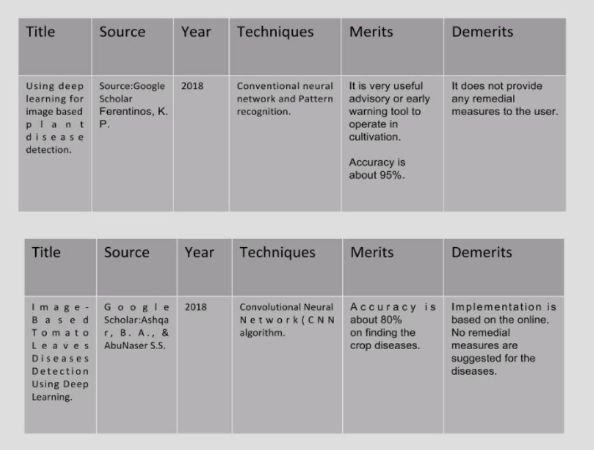
reference

Slide 10
THANK YOU

